Slide 1
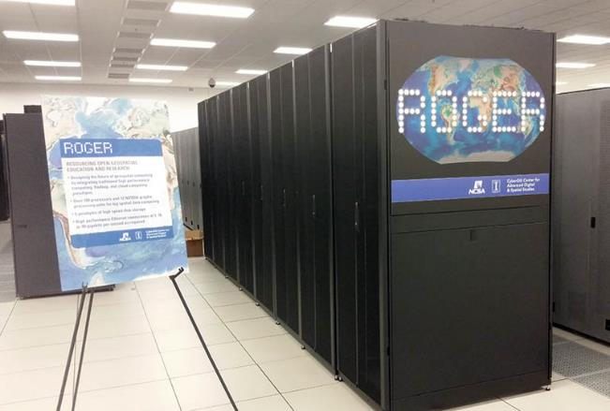
CyberGIS ROGER
Resourcing Open Geospatial Education and Research
Johnathan Rush
Geog. 479
Spring 2016

Slide 2

CyberGIS is Geographic Information Science and Systems based on advanced cyberinfrastructure.
Big Data
Big Compute
Big Collaboration
Big Problems
Notes:
Animation

Slide 3
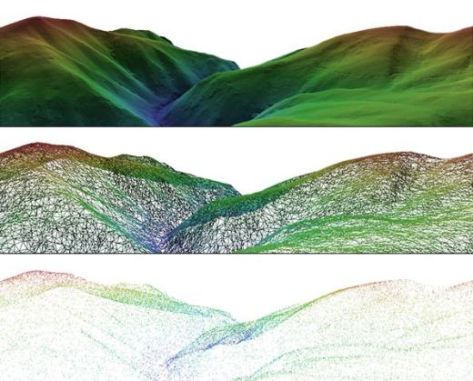
Increasing Data Size
National Elevation Dataset
30 meters: 175 GB
10 meters: 500 GB
1 meter: 50 TB to 4-5 PB
Notes:
This and next two slides are lead-in to why we have ROGER.
1 meter line: TB figure is for rasters, PB figure is for point clouds

Slide 4

Increasing Data Speed
Twitter Firehose
All Geocoded Tweets
~2.5KB / tweet
~6,000 average tweet per second
~3% of tweets are geolocated
~38GB per day

Slide 5
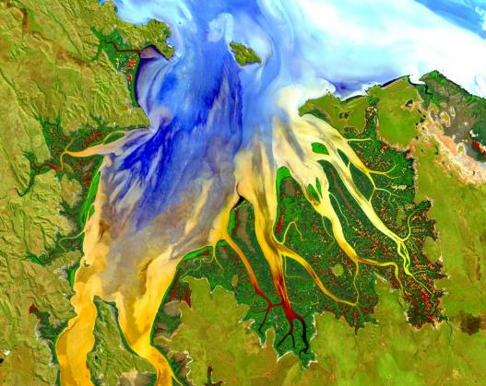
Increasing Data Speed
Landsat 8
~650 images per day
~1GB each (compressed)
~650gb per day

Slide 6
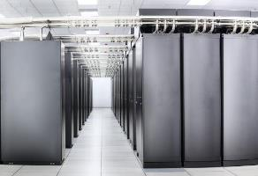
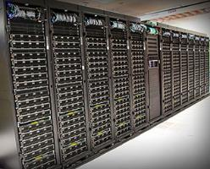
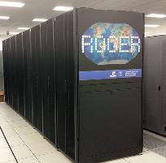
CyberInfrastructure Resources
NSF Blue Waters @ UofI
NSF XSEDE: SDSC Comet
CyberGIS ROGER
~45 TFlop/s
13,300 TFlop/s
2,000 TFlop/s
Notes:
Resources we have access to.

Slide 7
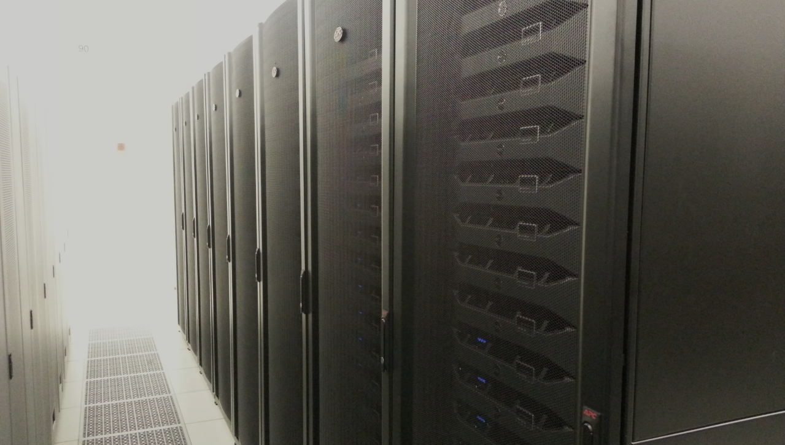
CyberGIS ROGER
Resourcing Open Geospatial Education and Research
after Roger Tomlinson
~45 TFlop/s
Notes:
Roger Tomlinson has been called the “Father of GIS” thanks to his leadership of the Canada Geographic Information System, the first computerized GIS.
The Tflops number for ROGER is theoretical, it has not been benchmarked yet. It is undergoing testing now, and should be fully open for use before fall semester. For more information, contact Johnathan (jfr@Illinois)

Slide 8
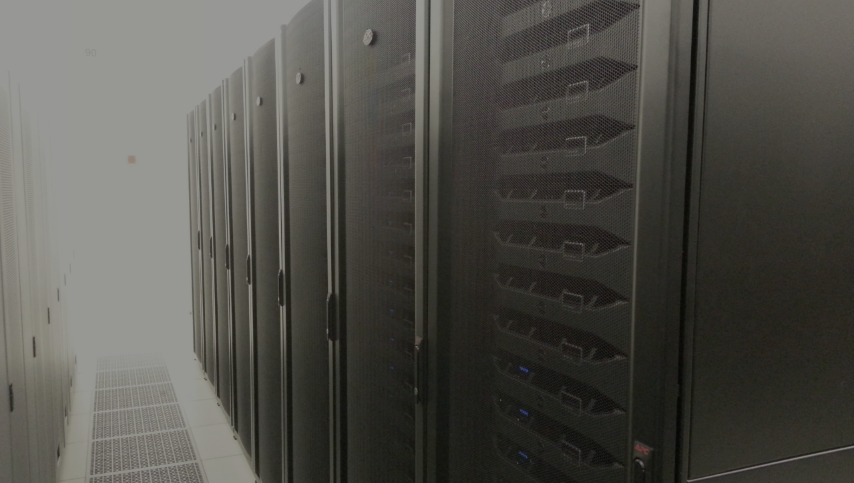
Why ROGER?
Configured to best support geospatial data, with emphases on local memory and shared storage size and speed
Supports multiple paradigms: traditional batch HPC, Hadoop, and Cloud (OpenStack).
Integrate the three paradigms and leverage their strengths
Both a research project and research resource
Inform the design of future geospatial supercomputers

Slide 9
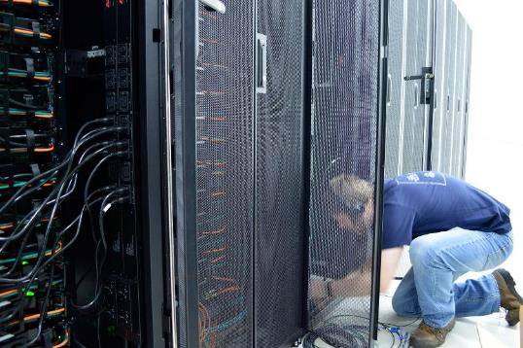
ROGER: Overview
Provides CyberGIS users with HPC, Hadoop and OpenStack functionality all on one system
Managed by Systems Group
With support from our storage, network, security and services groups

Slide 10
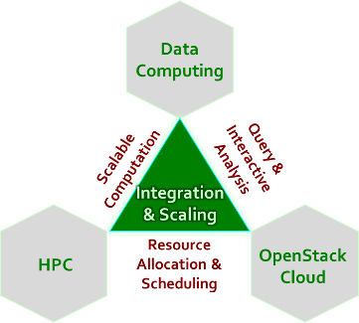
ROGER: Hardware
1 dedicated admin node
24 compute nodes (20 Cores + 128GB +10Gbe)
12 gpu nodes (+ 1 Tesla K40 gpu)
16 high mem nodes ( 256GB + 800GB SSD)
10 GPFS servers ( 256GB + 800GB SSD)
2 gridftp nodes (256GB + 800GB SSD + 40Gbe)
5PB of raw disk in 5 NetAPP E2700
Full info on the ROGER is at:
https://wiki.ncsa.illinois.edu/display/ROGER/ROGER+Technical+Summary
or https://goo.gl/RsHxQf

Slide 11
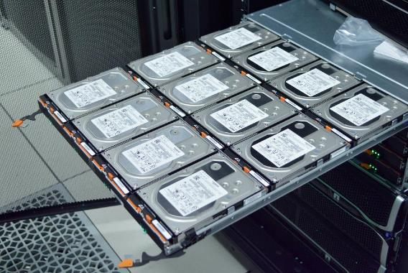
Storage
4.5PB usable
10 Storage servers & 5 Netapp Storage appliances
900 drives (6TB each)
GPFS
Fast Parallel filesystem
Common to all nodes
Supports batch HPC and Hadoop
Can export directories to Openstack

Slide 12
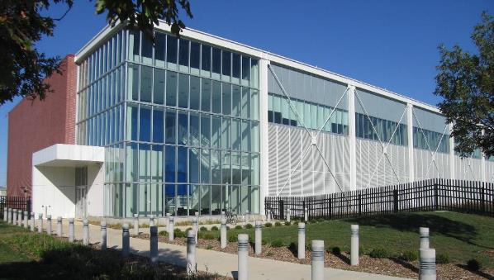
NPCF
National Petascale Computing Facility
New building
LEED certified Gold
Restricted access
24 hour Operations Center
Power & cooling at scale
Able to self-cool half the year
Co-located with
Blue Waters
iForge
Room for expansion in both Racks and Network capacity

Slide 13
ROGER User Community
Biosciences
Engineering
Geosciences
Social Sciences
Multidisciplinary
Agriculture
Medical Science
Bioenergy
Environmental Engineering
Transportation
Atmospheric Science
Hydrology
Geology
Remote Sensing
Geography and Spatial Sciences
Social Media & Network
Political Science
Computational and Data Sciences
Emergency Management
Environmental Sustainability
GIScience

Slide 14
Education and Training Opportunities
Useful knowledge across most ROGER applications:
Training opportunities exist through:
CyberGIS Commons
CSE
Software Carpentry
ROGER Helpdesk
Unix Shell
Batch Job Submission
Algorithm Parallelization
http://goo.gl/oKYZGB
http://goo.gl/S7xEqJ
http://software-carpentry.org/
help+ROGER@ncsa.Illinois.edu

Slide 15
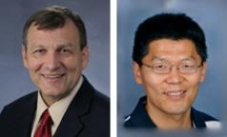
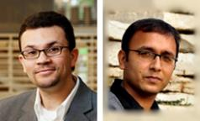
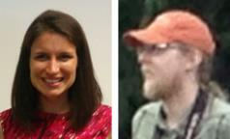
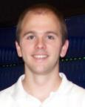
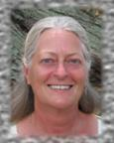
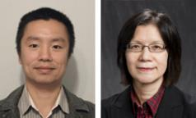
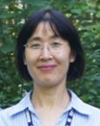
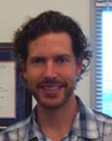
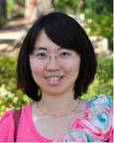
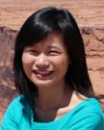
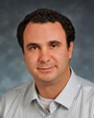
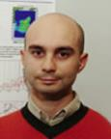
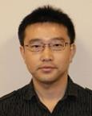
CyberGIS Fellows
http://cybergis.illinois.edu/about/fellows

Slide 16

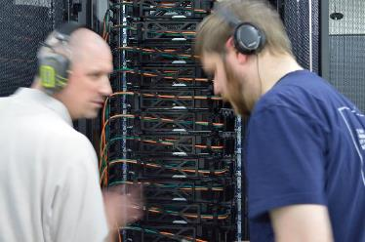
Acknowledgements
ADS – Brett Bode
Systems team – Dan LaPine, Chit Khin, Joe Muggli
Storage team – Andy Loftus, JD Maloney, Michelle Butler
Network team – Matt Kollross
ITS – Doug Fein
CyberGIS Center staff and students
NSF Award #1429699, MRI: Acquisition of a National CyberGIS Facility for Computing and Data-Intensive Geospatial Research and Education

Slide 17

Accounts
Expire at the end of the semester
Change password at go.Illinois.edu/NCSApassword
If you lose your password, email help@ncsa.Illinois.edu, and it will be reset to your default password on the paper.

Slide 18
Logging On to ROGER
Download Mobaterm for Windows if you don’t have a SSH client (http://go.Illinois.edu/mobaxterm - just run, no install)
Click Session button in top left corner, then SSH button
Enter roger-login.ncsa.illinois.edu in the remote host box, then click OK
Enter your username, then password. Don’t save your password if you are in a computer lab.
Next time you open MobaXTerm, roger-login will be a saved session in the left sidebar you can double-click to start
Or, use Terminal on Mac and Linux
ssh -X username@roger-login.ncsa.illinois.edu
(enter your password when prompted)

Slide 19
Common Commands
cd change directory
pwd displays your current directory
ls list the files in your current directory
ls test* list all of the files starting with “test” in the directory
ls -l list the files in a directory with details
mkdir name create a directory
rm remove (delete) file
rm -r remove a directory
cp origin destination copy a file
cp -r origin destination copy a directory and its contents recursively
mv origin destination move or rename a file
chmod g+rw filename set the file to be readable and writeable by group members
hdfs dfs -ls directory list the files in the specified directory of the Hadoop File System
Hadoop has no concept of a “current” directory

Slide 20
File system
Purpose Path Shortcut
Home Directory /home/userid ~
All Projects /gpfs/largeblockFS/project /projects
Course Project /projects/class/g479
Scratch /gpfs/largeblockFS/scratch /gpfs_scratch
Software /gpfs/smallblockFS/sw /sw

Slide 21
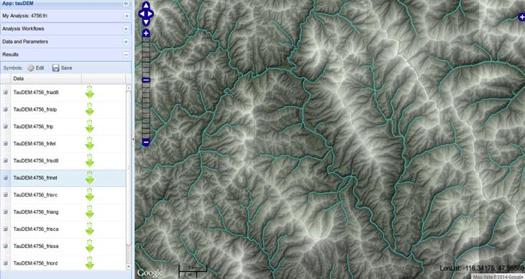
Parallel Applications
http://hydrology.usu.edu/taudem/taudem5/index.html

Slide 22
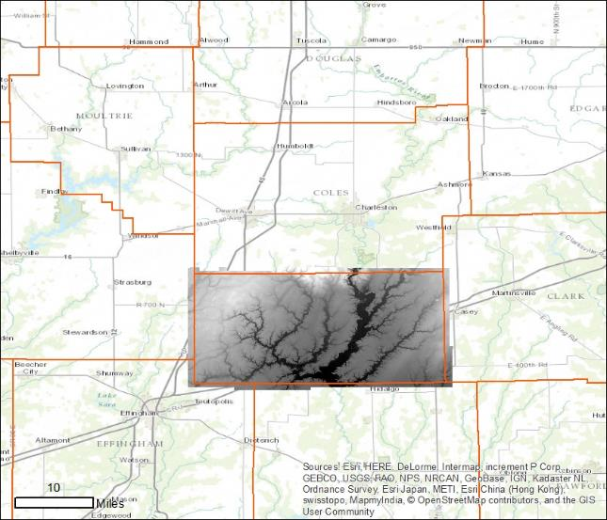
Cumberland County 1m DEM from Lidar

Slide 23
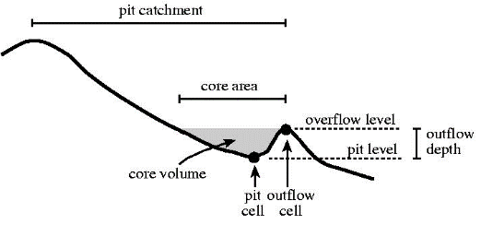
Pit Remove DEM
Get your own compute node to work on
(called an interactive session)
qsub -I -l walltime=0:30:00
Run TauDEM
module load mpich taudem
mkdir ~/output
mpirun -n 20 pitremove -z /gpfs_scratch/il_lidar/geotiff/uncompress/ -fel $HOME/output/
Open another terminal to view CPU usage
Right-click the MobaXTerm tab, click Duplicate tab. Log in again.
Then, ssh into the node that your TauDEM job is running on. If your prompt in your other window says username@cg-cmp12, then you would enter ssh cg-cmp12 in your new terminal.
Enter top to see the current CPU usage. Quit top with the q key.
Notes:
discuss modules
pit is one or more cells with no downstream cells around it. they become sinks and isolate portions of the watershed.

Slide 24
GNU Parallel Example
Copy data
cp -R /projects/EOT/workshops/datapar ~
cd ~/datapar/ned10m
Multitasking with GNU Screen
screen
Reproject all GeoTIFFs matching a filename pattern, saving results in new directory
module load parallel
module load gdal-stack
find -name \*.tif | parallel "gdalwarp -t_srs epsg:3269 {} {.}_proj.tif“
Multitasking with GNU Screen
ctrl-a d #disconnect from current screen session. That’s ctrl-A, then D
top #check CPU usage
screen –x #reconnect to previous screen session

Slide 25
ROGER Statistics
roger-stats.ncsa.illinois.edu
clustat.ncsa.illinois.edu/roger/

Slide 26
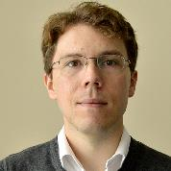
Questions?
Johnathan Rush
jfr@illinois.edu
cybergis.illinois.edu

